Slide 1
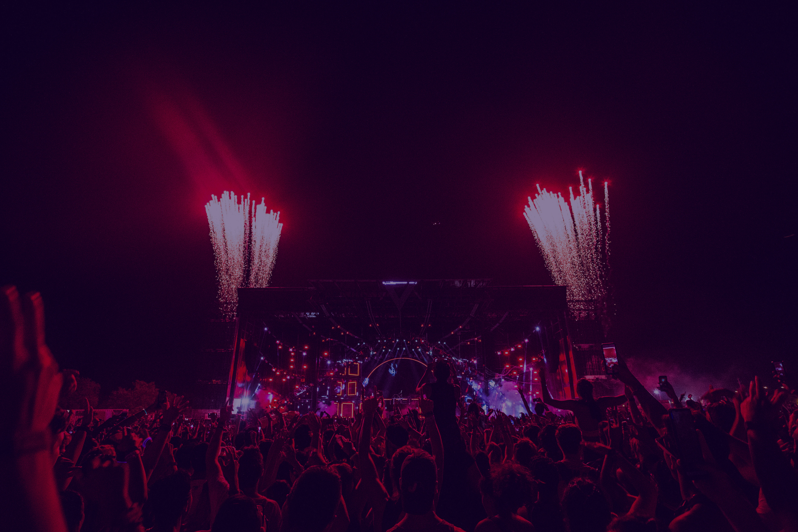
MUSIC FESTIVAL
Feel the Beat. Live the Moment
Location: The Main Student Hall, William College, London
Date: 15 th February, Sunday, 2026
Time: 5.30 pm to 11.30 pm

Slide 2
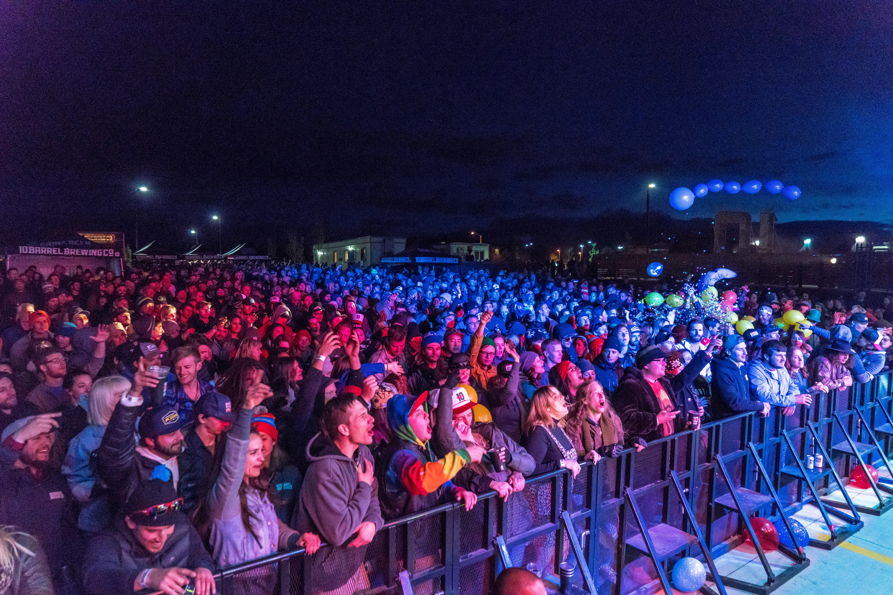
ABOUT THE FESTIVAL
You are invited to an exciting music fest, which is the ultimate student night out.
This music event is designed to help you relax and have fun outside the classroom. Whether you are a new student or pass out, this event is a perfect opportunity for meeting and greeting new people, making new friends, and enjoying a bubbly social atmosphere.

Slide 3
AMMNETIES OF THE FEST
Join us on the 15th of February 2026 at the Student Concert Hall, in the evening, around 5:30 p.m. The evening will be filled with music, interactive games, and activities. There will be refreshments and food to support your energy. Besides music, there will be fun-filled activities and games so that everyone feels welcome and encourages teamwork and laughter. There will be plenty of space to unwind and enjoy yourself.

Slide 4
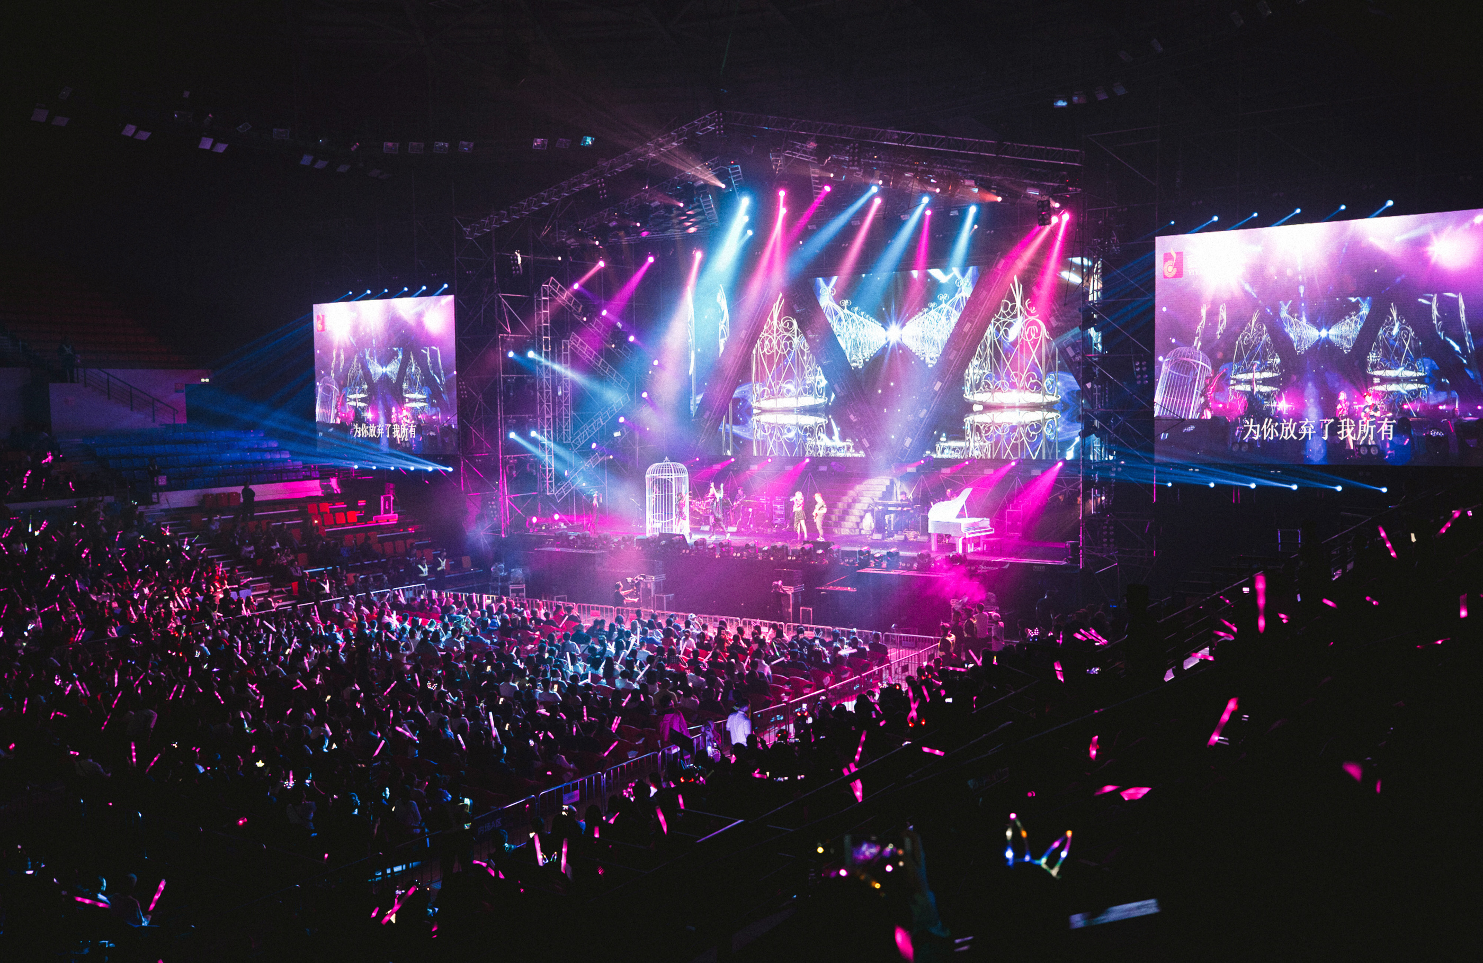
FESTIVAL ZONES
At the heart of the music festival lies a vibrant world beyond the performances. A place designed for exploration, relaxation, and connection. From the moment you step in, you're invited to experience more than just music. Here are the unique zones waiting to be discovered:
  Main Stage
  Silent Disco Tent
  Food stalls
  Art Installations
  Chill Lounge & Wellness Space

Slide 5
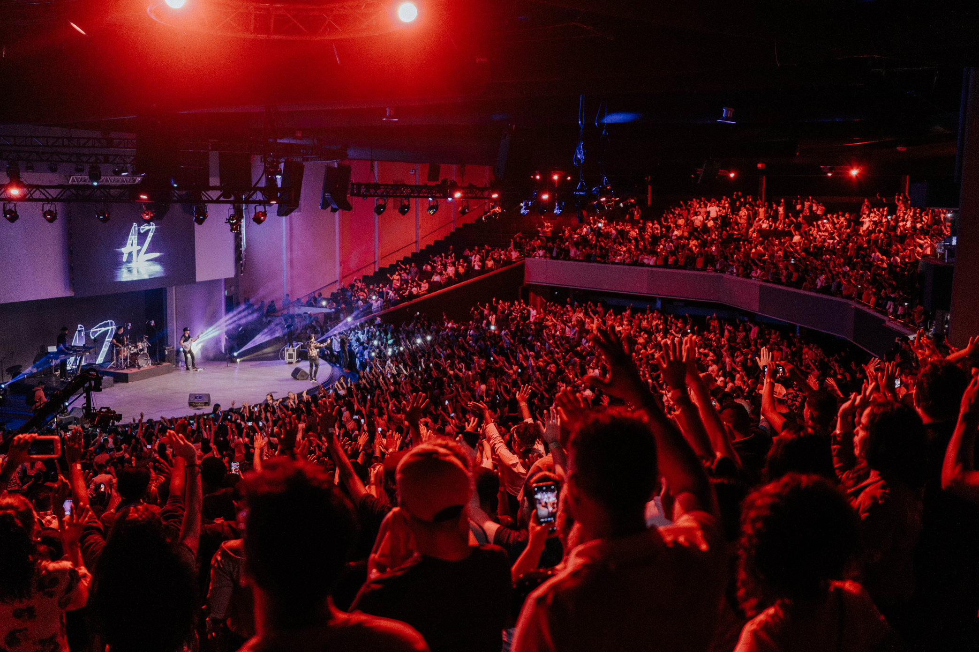
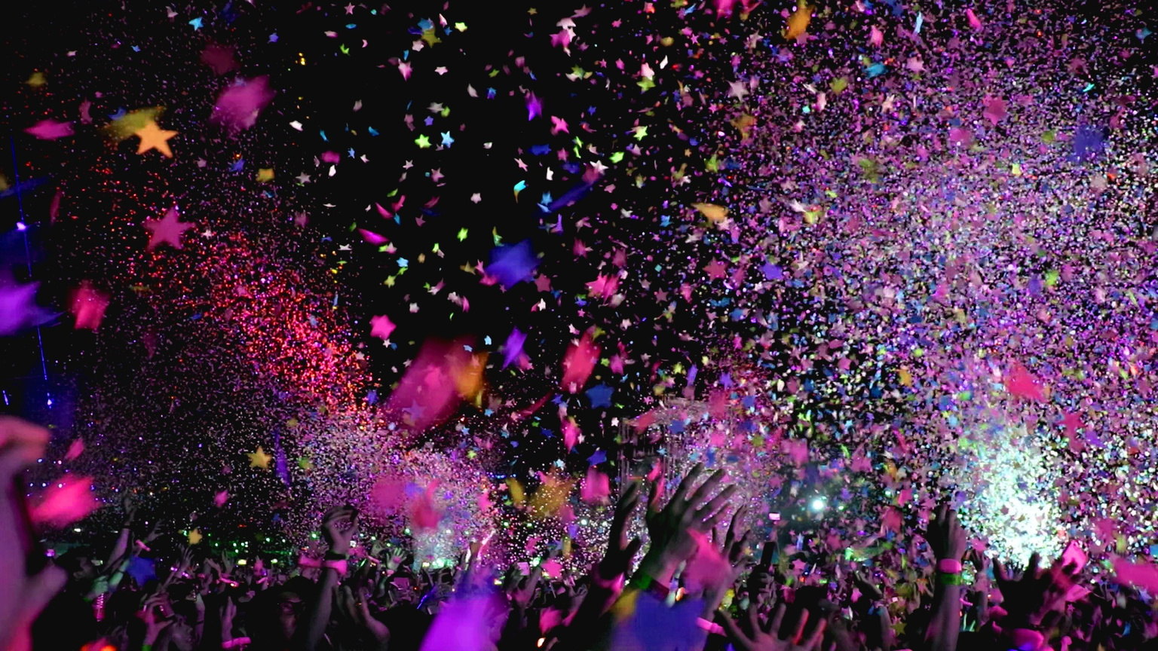
LOCATION & ACCESS
Venue:
The Main Student Hall, William College, London
We've chosen a vibrant and open venue to ensure your festival experience is both exciting and comfortable. Whether you're arriving by car, public transport, or shuttle, getting here is easy and convenient.
Transport Options:
Easily accessible via public transit routes, with dedicated festival shuttles available throughout the day.

Slide 6

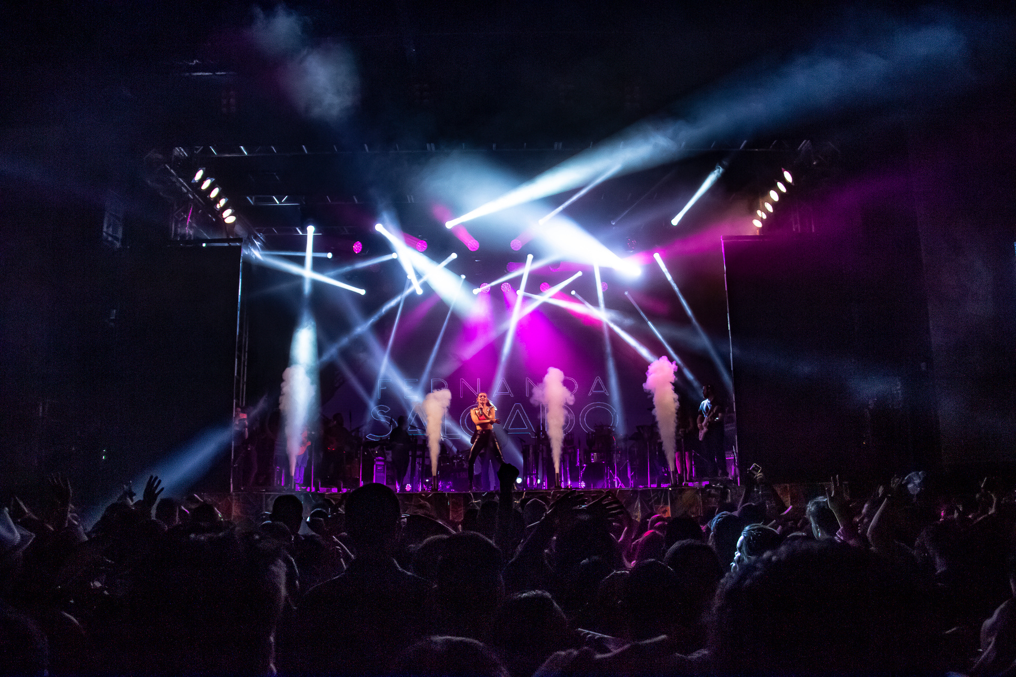
WHY JOIN US?
This event is open to all students, so bring your friends to the venue and create lasting memories and experiences. This music and fun night are organised to take a break from the academic routines and stranded in the student community.

Slide 7

THANK YOU
Get Your Tickets Now!
We are looking forward to seeing you at the event, and come with lots of positive energy and get ready for a fun field evening
RSVP: Please confirm your attendance by the 10th of February by signing the form at the student services office

